Slide 1
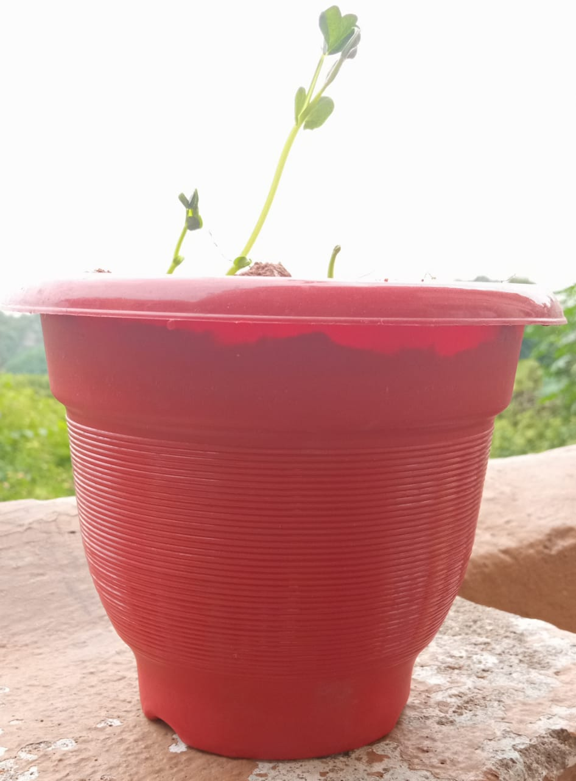
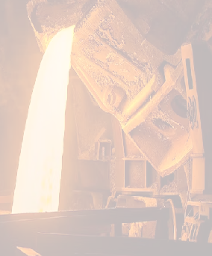
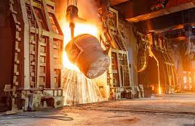




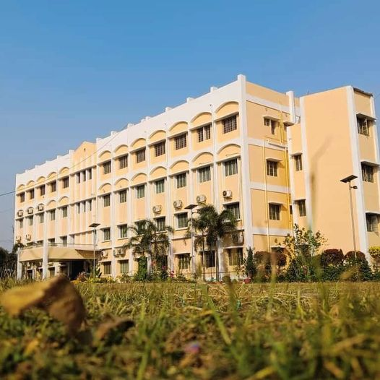
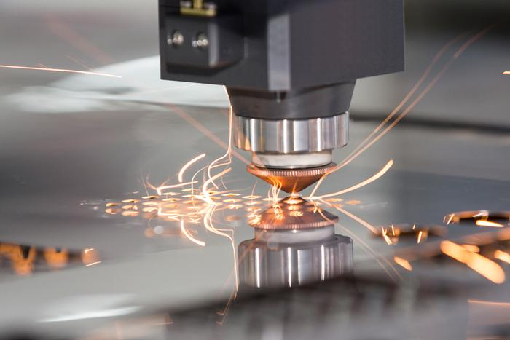



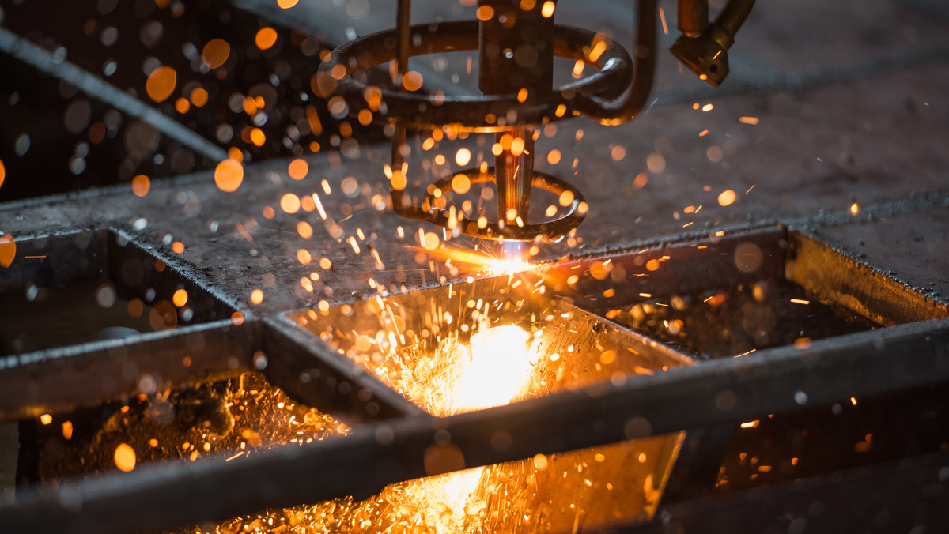
ICPMMM2024
International Conference on Processing
of Minerals, Metals, and Materials :
Beyond Tomorrow
21-23 February, 2024
ORGANIZED BY
Department of Metallurgical Engineering, Kazi Nazrul University, Asansol, INDIA
In Association With
Department of Metallurgical & Materials Engineering, Jadavpur University, INDIA
Department of Metallurgical & Materials Engineering, National Institute of Technology, Durgapur, INDIA
VENUE : FAIRFIELD BY MARRIOTT, KOLKATA, WEST BENGAL, INDIA

Slide 2
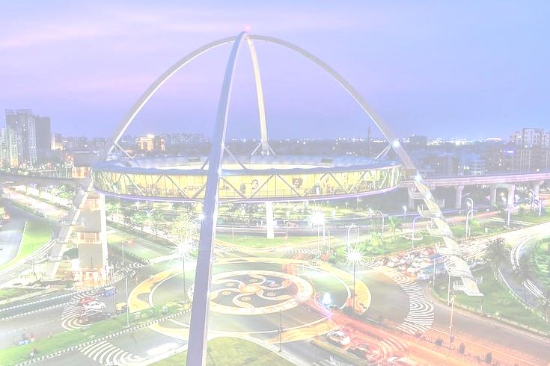
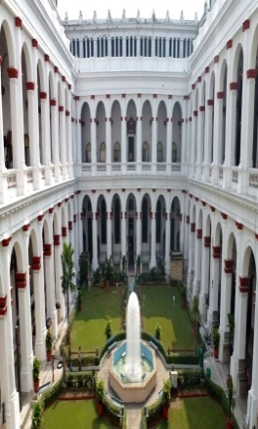
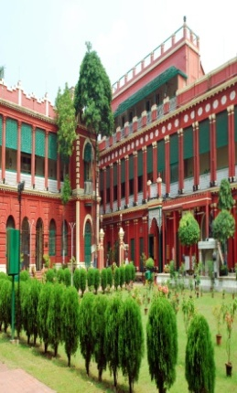
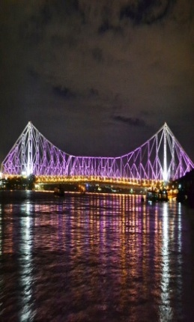
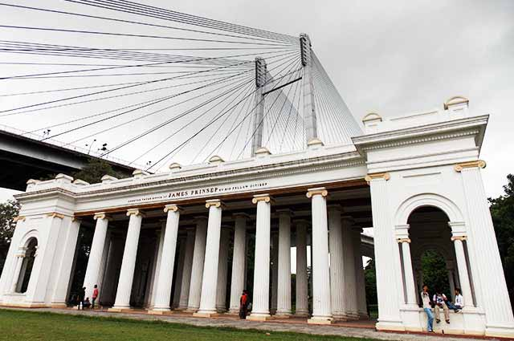
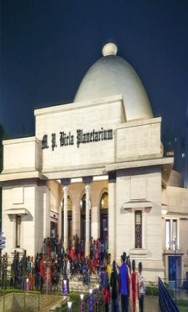
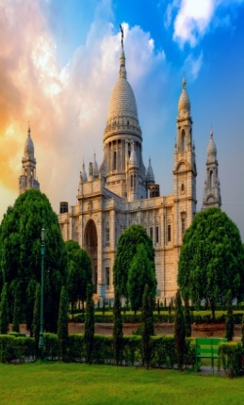
ABOUT THE UNIVERSITY AND THE DEPARTMENT
https://icpmmm2024.in/ ICPMMM2024
Kazi Nazrul University (KNU), a nascent university in the heart of industrial belt in West Bengal, runs on its campus and also in its affiliated colleges Diploma, UG, PG, MPhil and PhD courses in the Faculty of Arts and Fine Arts, Faculty of Science & Technology, Faculty of Law, and Faculty of Commerce & Management. It caters to the need of more than forty four thousand students every year. Within eight years of its existence, KNU has put a mark in academia by way of imparting knowledge, developing skills, promoting entrepreneurship among students for making them competent as per needs of the society from the local to the global in various fields including research & development. Various initiatives have already been taken to internationalize the University for connecting it globally with institutions of repute. As an academic institution, KNU believes in four I's : Inspiration, Innovation, Inculcation and Integration. The Department of Metallurgical Engineering in the School of Mines and Metallurgy, KNU, started offering three years diploma in Metallurgical Engineering from 2017. The Department has started offering B. Tech. in Metallurgical and Materials Engineering from 2019 onwards. Both the Diploma and Degree courses are approved by AICTE. The Department has its own Board of Studies (BOS) and Board of Research Studies (BRS) with experts from eminent institutes, e.g. IITs, Jadavpur University, etc. Besides teaching, faculty members are also engaged in collaborative research with various academic and research institutes, and industries. Students undertake vocational training, internship, and research projects in various reputed organizations like IISCO, Tata Hitachi, NML, RINL, and nearby iron and steel plants.
KOLKATA CITY
Kolkata, one of the biggest cities in India, is a perpetually ongoing festival of human existence, concurrently luxurious, refined, warm, and pointedly futuristic. A vibrant 350-year-old metropolis located on India's Eastern Coast, the capital of West Bengal thrives on contradictions and imposing spectacles; nothing is commonplace in this city. Kolkata, the City of Joy, in every sense, is the artistic, cultural and intellectual capital of the country. Netaji Subhash Chandra Bose International Airport, about 15km from the city centre, is well connected with other parts of India and abroad as well. Kolkata's streets are vivid, hectic, chaotic, and yet, brimming with life and creativity. Driven by the indomitable spirit of the self-made middle class, the city has created a beautiful juxtaposition of the old colonial-era charm with the nascent upcoming hipster culture that thrives amongst the city's millennial residents. Kolkata has a very lively nightlife and great street food that is famous all across the country. The city is lined with eateries and food stalls at every corner, where you can savour traditional Bengali food, or try out local snacks, like, Jhalmuri, or Ghugni Chaat. You just cannot miss the omnipresent sweetmeat shops all around. Weather in Kolkata in February is soothingly enjoyable, with temperature between 16-29ºC and mostly bright sunny days.
VENUE
Fairfield by Marriott, the venue, is one of the best hotels in Kolkata, located in the Newtown area, with nice amenities and away from the city chaos. It is 5 km from the Metro Station, 8 km from Sealdah Railway Station and 11 km from the international airport.

Slide 3
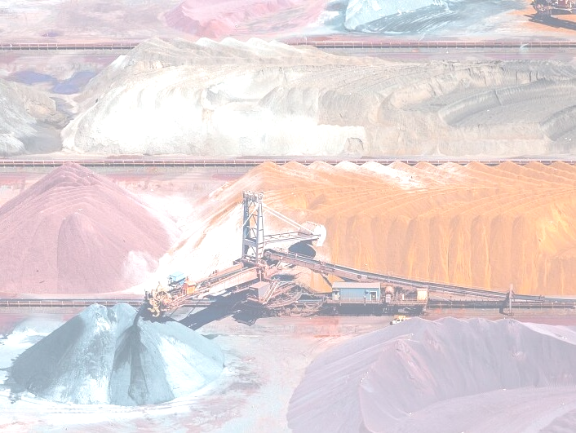
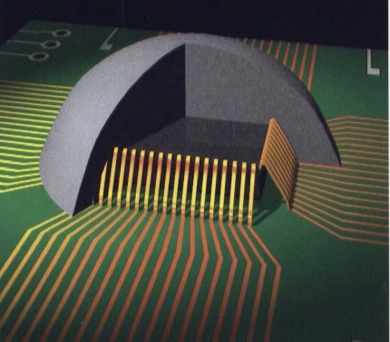
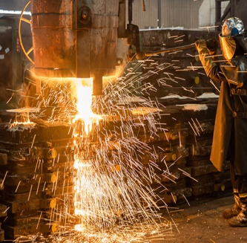
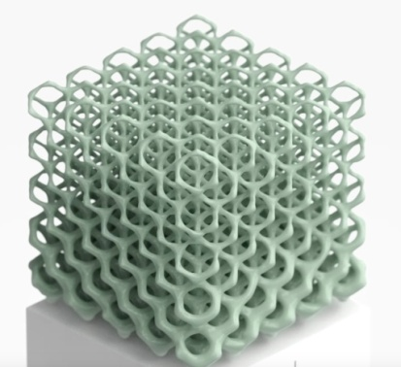

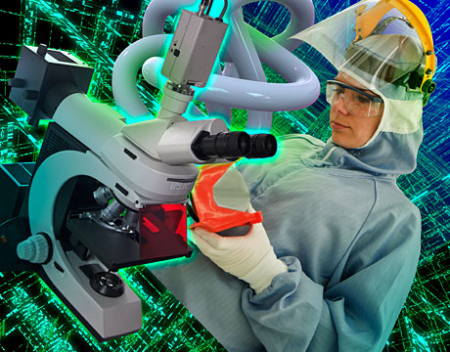
Invitation
https://icpmmm2024.in/ ICPMMM2024
At the onset, we want to introduce ourselves as a fledgling Department of Metallurgical Engineering of Kazi Nazrul University, a state aided university in the eastern state of West Bengal, India. We are running AICTE approved UG courses as well as doctoral programs duly supported by required infrastructures, well qualified faculty members, close collaborations with industries and research labs, and external fundings. Our faculties are actively engaged in teaching and research and we strive to keep pace with the fast changing world of Minerals, Metals, and Materials through our research programs. Major areas of research include but not limited to : Iron and Steelmaking, Degradation of Materials, Composites, Alloy Development, Smart and Functional Materials, Nano Materials, Environmental Management in the Metals and Minerals Sector, Value Addition to Wastes, Traditional Metalcraft, Structure - Property Correlation, Materials Characterization, etc.
We are always open to the fast changing and fascinating world of minerals, metals and materials and we strive to keep ourselved abreast of their local and global developments. Organizing this conference is a sincere endeavor to bring the gamut of academicians, professionals, reseachers, policy makers, and students to exchange views and share visions with a focus on the developments in near and far future. We cordially invite you for your active participation to make the conference a success.

Slide 4

https://icpmmm2024.in/ ICPMMM2024
Call for Papers
ICPMMMM2024 will cover a wide range of themes spanning the entire spectrum of activities related to minerals, metals, and materials that are of current and possible future interests to researchers and professionals from academia, research, industry, and policy makers. ICPMMM2024 will provide a knowledge sharing platform on technological advances and will promote collaborations and dialogues among leaders, experts, budding professionals, researchers, and students so that they can utilize the mutual strengths to deliberate on challenges and opportunities. The IPCMMM2024 will consist of theme based parallel sessions that will be inspiring for the professionals and students through career opportunities, technology trends, industry and society needs. The ICPMMM2024 will be structured around a few broad verticals, which would appropriately leverage invited & keynote lectures from leading experts in the related fields as well as contributory papers presentations. Overall, ICPMMM2024 programme is sure to provide the participants an enriching experience. The paper should only be submitted by Email at icpmmm2024@gmail.com. The conference invites contributions on the following themes but not limited to:
Broad Theme of the Conference
“Processing of Minerals, Metals and Materials : Beyond Tomorrow”
There will be one dedicated parallel event on “Green Steel : Concept to Reality” on 22 February 2024 comprising of three sessions.
Other Sub-Themes
• Ore Beneficiation • Mineralogical Characterization • Process Mineralogy, Design and Development of Mineral Processing Equipments and Process • Simulation of Mineral Processing Circuits • Agglomeration of Ores • Iron Making & Steel Making • Non-Ferrous Extractive Metallurgy, • Hydrometallurgy • Nano-Materials • Bio-Materials • Composites • Material Science and Engineering • Metallography • Materials Property and Characterization • Materials Testing and Control • Microstructure Evolution • MEMS Integration • Meta materials • Ceramics • Electrical, Optical, and Magnetic Materials • Intermetallics and Special Polymers • Nano materials and their Fabrication • Numerical Modelling and Simulation • Alternate materials / material substitution • Computational Modeling • Advanced alloys • Optical and Electronic Materials • Microelectronics • Electronic packaging materials • High Entropy Alloys • Ultralight Alloys • Semi-solid Processing • Metallic Foams • Tribology • Sustainable Materials • NDT • Life Cycle Analysis • Thin Film Technology • Coatings • Pollution Abatement • Zero Emission • Nano-electronics • Membrane Materials • Catalysis • Materials Chemistry • Battery • e-waste Processing • Solar Cell • Photovoltaic Materials • Energy Storage • Carbon Capture • Hydrogen Storage • Sintering • Powder Metallurgy • Atomization • Metal Forming • Devices • Surface Engineering • Medicinal Implant Materials • Self-healing Materials • Thermoelectric Materials • 3-D Smart Materials • Carbon Nanotubes, Graphene and Composites • Piezoelectric Materials • Semiconductor Materials • Ceramics, Glasses & Composite Materials • Advanced Nanomaterials • Renewable materials • Functional Materials • Dental Alloys • Conducting Polymers • Metal Joining • Computational Materials Design • Evolutionary Structural Materials • Energy Storage & Conversion Materials • Hybrid Materials • Fuel Cell • Optical fibers and displays • Controlling and Monitoring Devices • Solid State Ionics • Design, Synthesis and Characterization • Smart/Intelligent Materials in Automation and Control • Dielectrics, Nanoscale and Photonic Materials • Intelligent Semiconductor Models • Conventional Superconductor • High-temperature Superconductivity • Detectors, Emitters and Metallization • Thermoelectric and Energy Applications • Additive Manufacturing & 3D Printing • Applications of AI • Corrosions and Degradations • Energy Management • Energy Audit • Environment Impact Assessment

Slide 5
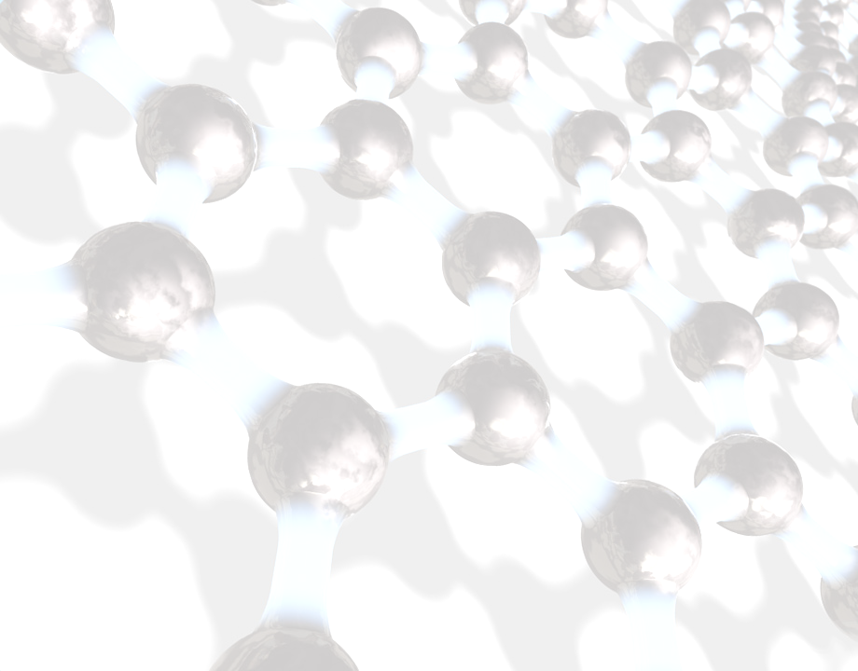
https://icpmmm2024.in/ ICPMMM2024
Call for Abstracts
Authors are requested to submit abstracts latest by 31st October 2023. The abstract, not exceeding 500 words with maximum five keywords and prepared as per the guidelines, should be submitted through Email at icpmmm2024@gmail.com. The abstract should be prepared using template provided on the conference website.
Abstract Submission Deadline 31st October, 2023
Guidelines for Authors
The abstract of the Paper within 500 words with a maximum of five keywords has to be submitted first and after acceptance of the same, the full text of the paper has to be submitted.
Domain experts will review the Abstract and the decision will be communicated to those authors whose Abstract is accepted.
Full Text Paper should be prepared in line with the following.
Papers should be camera-ready in MS-Word format, not exceeding 3000 words in length excluding figures, tables, appendices.
The language of the publication is English. The mode of presentation should be in third person.
SI units should be used wherever possible. Other units, if used, should be given only in parentheses preceded by SI units.
Mathematical symbols should be typed and care should be taken to differentiate between similar characters (e.g. 1 and I), upper and lower case letters and superscripts and subscripts.
Lengthy mathematical proofs and derivations and extensive test data are discouraged. If absolutely essential, they should be given as appendices.
Publication Opportunity
The good quality research papers from the conference, after thorough peer review, will be published in a Springer journal. The publication of a paper will be subject to the referee’s decision through peer review process and submission of copyright agreement and less than 15% plagiarism report.
Key Dates
Abstract Submission : 31st October, 2023 Full Paper Submission : 15th December, 2023 Full Paper Acceptance : 15th January, 2024 Registration Deadline : 31st January, 2024

Slide 6
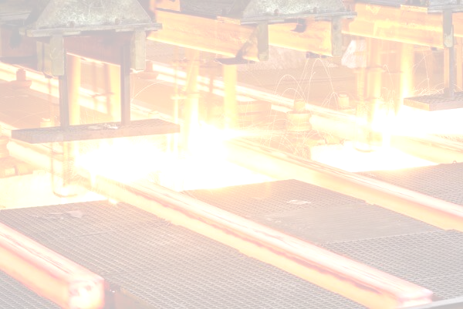


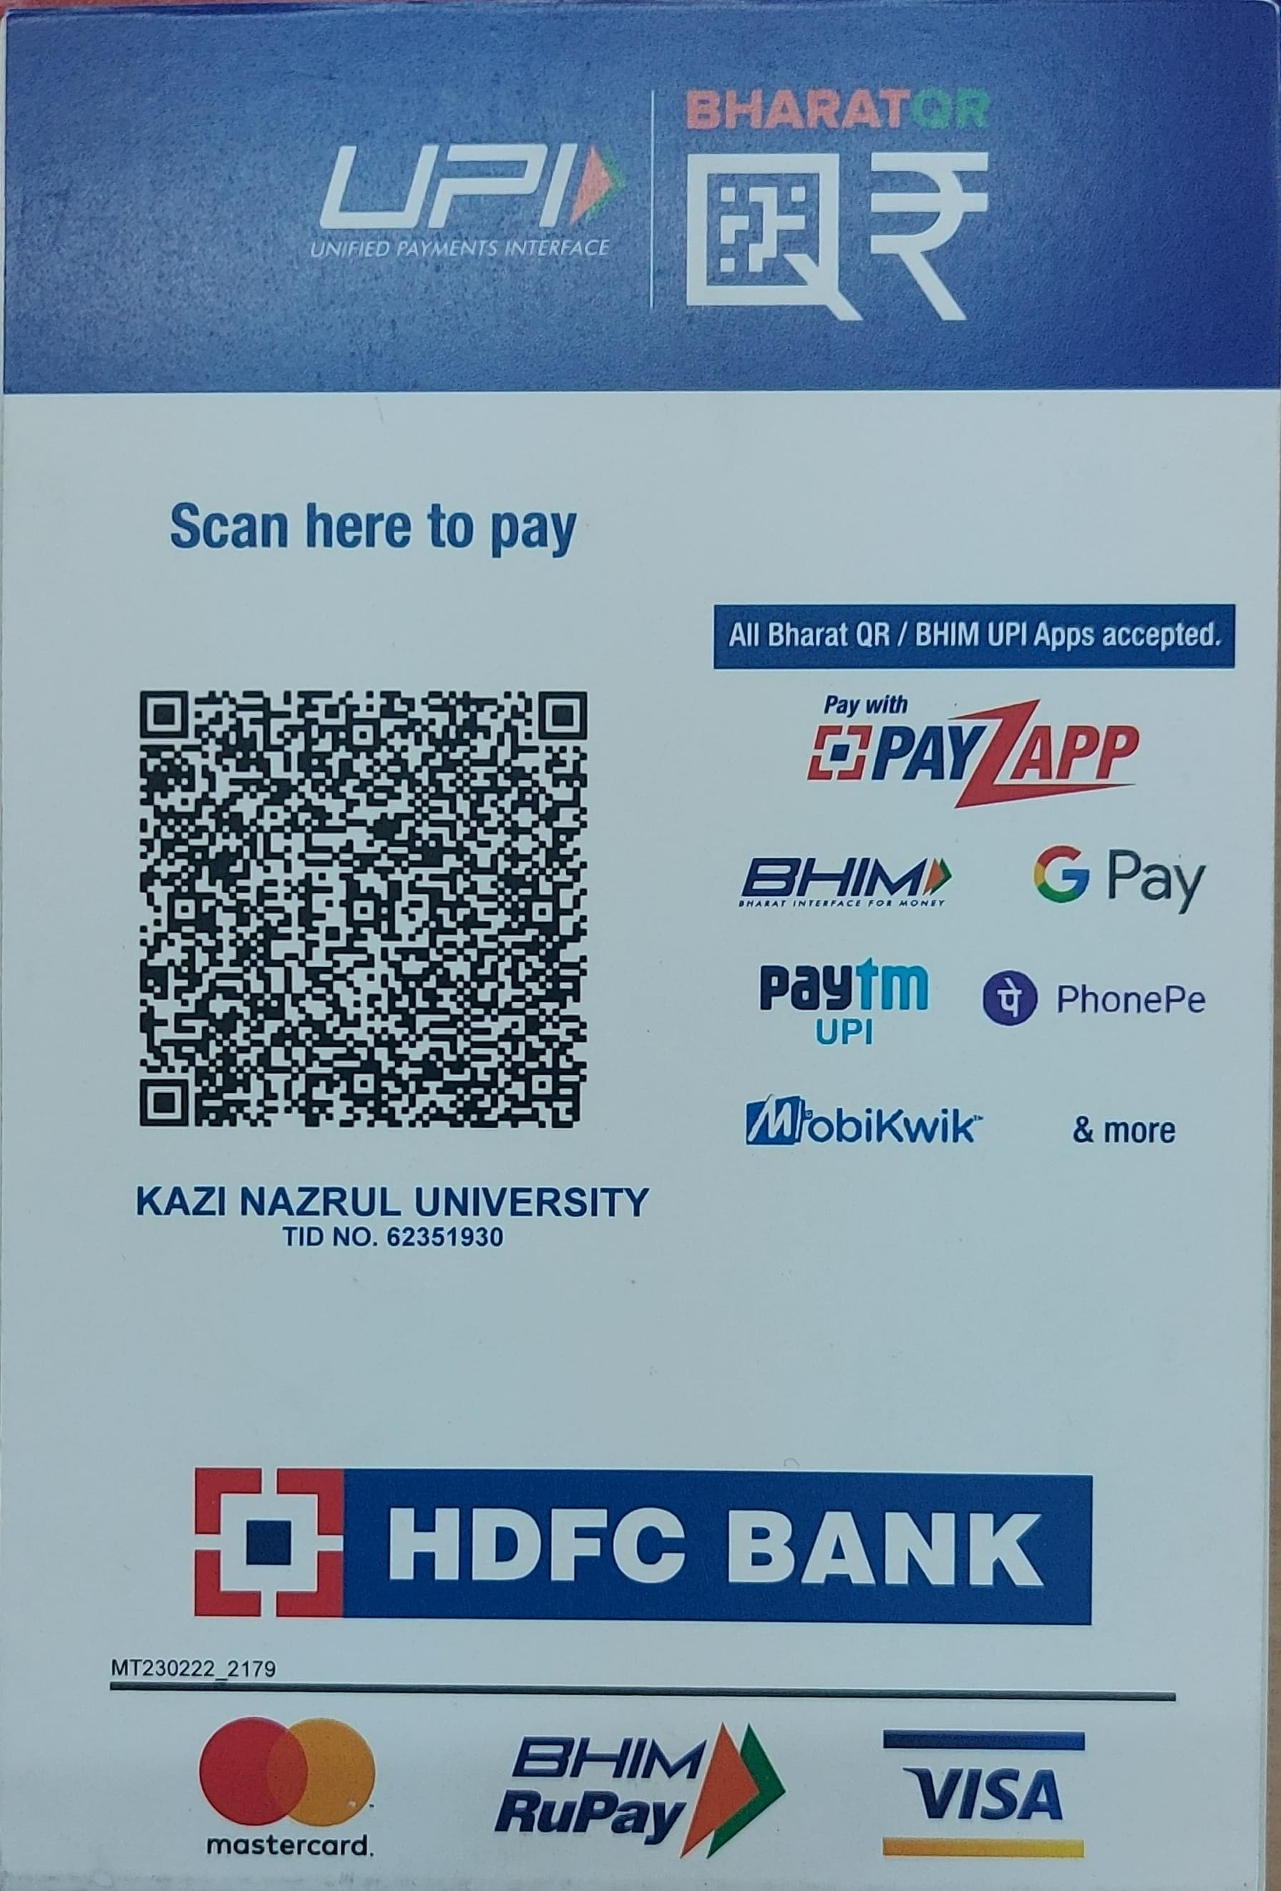
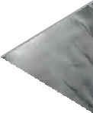







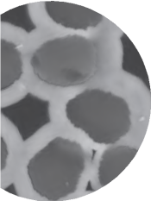
https://icpmmm2024.in/ ICPMMM2024
Registration
Delegates are requested to register and pay online
CATEGORY | INR | USD
ACADEMICS | 8000 | 300
INDUSTRY and R&D lab | 9000 | 400
Students | 4000 | 150
ACCOMPANY/ SPOUSE | 4000 | 150
Note: Registration is mandatory to participate
(excluding GST)
Registration and Payment Link :
Registration Link :
https://docs.google.com/forms/d/1I_CkazyrMsuG8mRVAC3HyJ6LvN2ORfP5qnD5u4tpmFI/edit?chromeless=1
Bank Details :
Account No. :50100489460550
Bank Name :HDFC
IFSC Code : HDFC0000324
Branch Name : ASANSOL
Prospective participants are requested to visit https://icpmmm2024.in/ for latest updates.

Slide 7

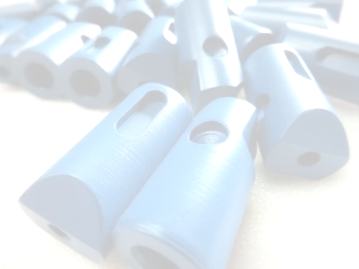
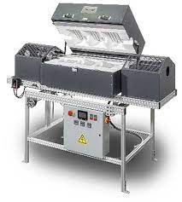
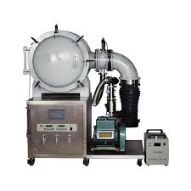
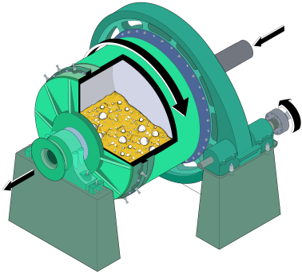
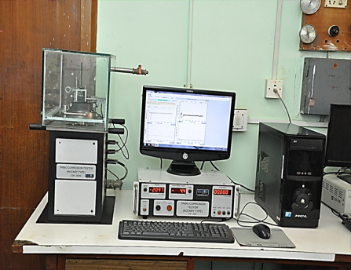
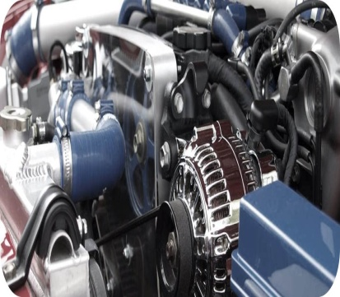
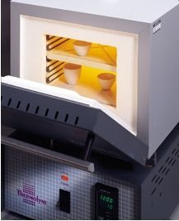
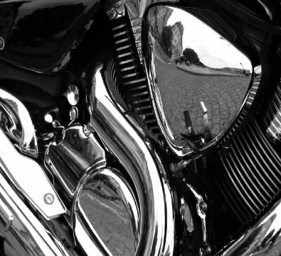
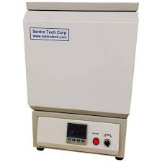
Souvenir
https://icpmmm2024.in/ ICPMMM2024
Special Attraction
We would like to come forward to promote the Dokra Art which is an ancient and traditional metalcraft practiced in many parts of India, including West Bengal. Unfortunately, however, this special art form is struggling for its existence due to various socio-economic reasons. We want to create more awareness among people to take interest in this unique metalcraft that will help the Indian metallurgical heritage survive and flourish. We are planning to give a piece of Dokra casting to each participant as a memento.
During ICPMMM2024, a Souvenir will be released. The Souvenir will contain messages from Govt. functionaries and eminent professionals, special articles, event details, details about various committees, sponsors/ supporters and advertisements from various industries, organizations from India and abroad.
The soft copy of the souvenir will be provided to all the delegates attending the event. Limited high quality hard copies will be printed for distribution to Govt. agencies, Industries, R&D labs and Academic Institutions.

Slide 8
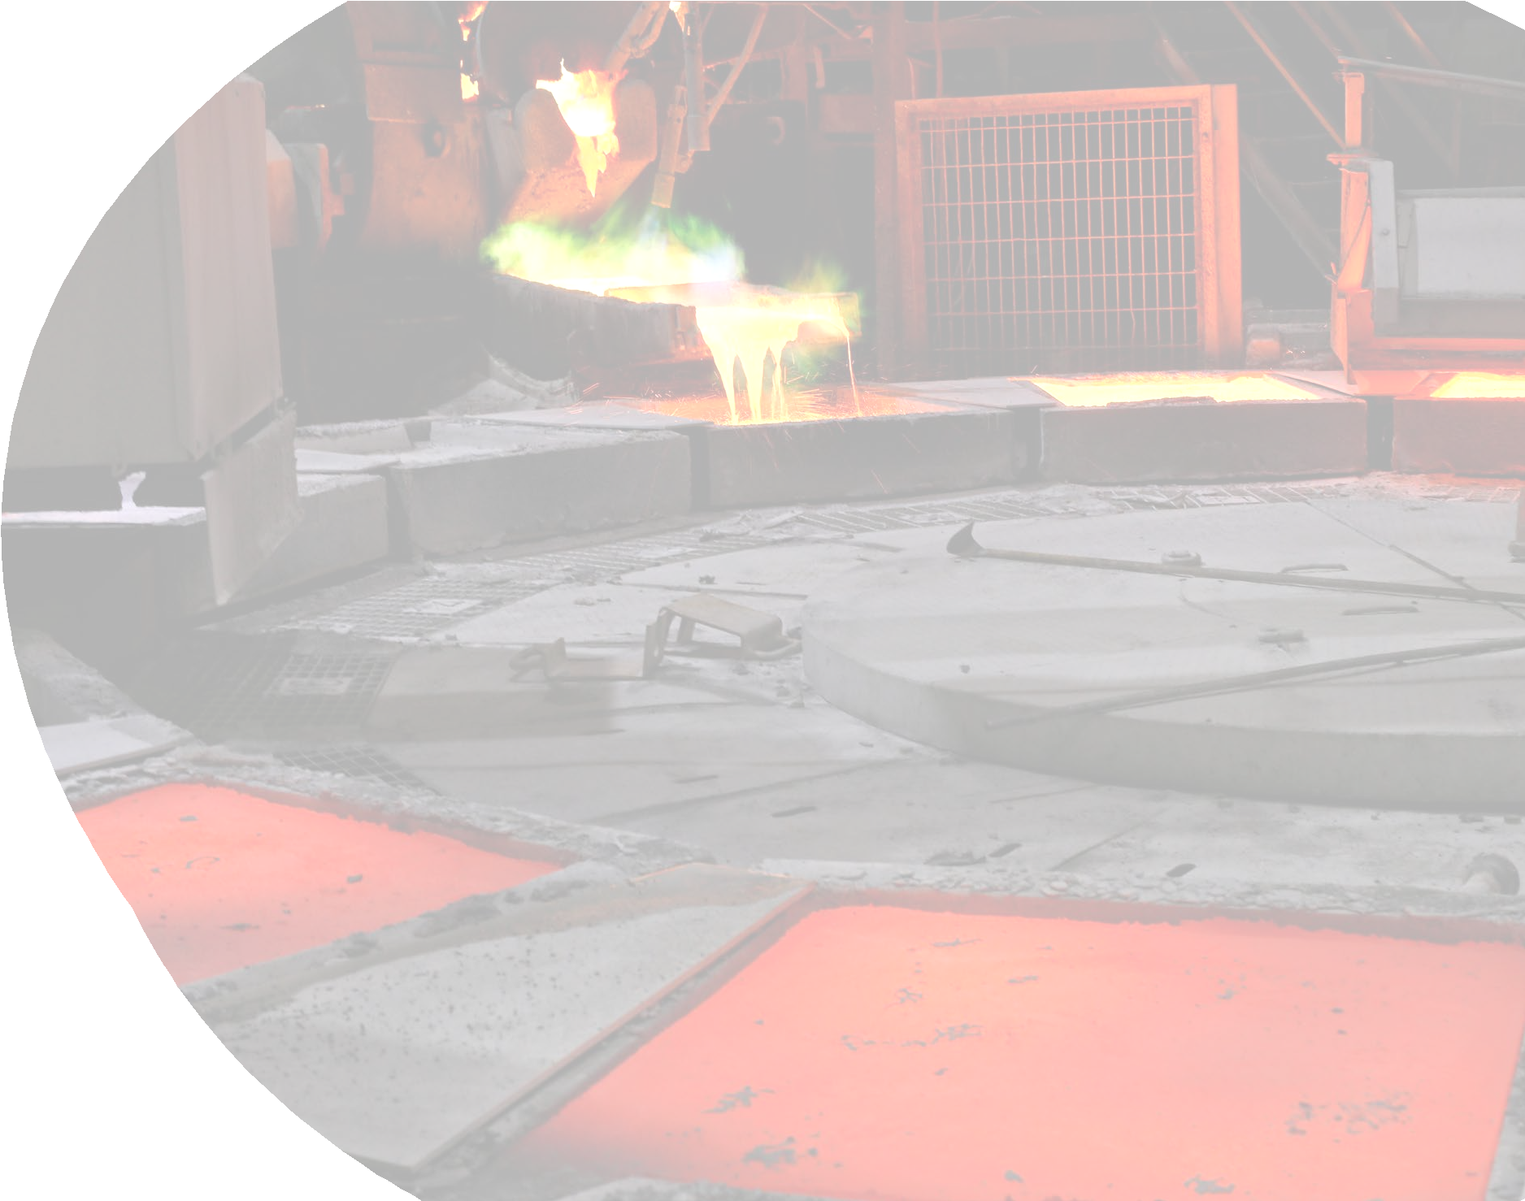

https://icpmmm2024.in/ ICPMMM2024
ICPMMM2024
Committees for ICPMMM2024
Chief Patron
Prof. (Dr.) Debashish Bandyopadhyay, Vice Chancellor, KNU
Patrons
Dr. Chandan Konar, Registrar, KNU
Prof. (Dr.) Santanu Kumar Ghosh, Dean Faculty of Science and Technology, KNU
Chairman
Prof. (Dr.) Projjal Basu, KNU
Advisory Committee
INTERNATIONAL Prof Cheong Kuan Yew, USM, Malaysia Ts. Dr Teo Pao Ter, UMK, Malaysia Dr Samayamutthirian Palaniandy GM, Eirich Australia/Global Product Manager Prof Elizabeth Makhatha, HOD, Metallurgy, Univ Johannesburg Mr Ram Chandra Chakraborty, MD, PSI Metals India Private Limited Dr Anrin Bhattacharya, CEO, RECYRON, Austria Mr Saikat Chatterjee, Tata Steel, Ijmuden Dr Kamalesh Mandal, Steel Dynamics Prof Ir Dr Wong Yew Hoong, UM, Malaysia Dr Saikat Samanta, AGM Process & Sales, NewFer, Germany | NATIONAL Prof Rajeev Ahuja, Director, IIT Ropar Prof Pravas Chandra Chakraborti, HOD, Metallurgy, Jadavpur University Mr Arup Krishna Saha, COO, MINEX Metallurgical Company Limited Prof Sumantra Bhattacharya, Emeritus Fellow, IIT Dhanbad Prof Govind S. Gupta, IISc Bangalore Dr Ashis Bhaduri, CEO, TATA Bluescope Prof Somnath Basu, IIT Bombay Prof Samit K Roy, IIT Kharagpur Mr S K Dutta, MD, Duttcon Consultant & Enigineers, Kolkata Prof Karabi Das, HOD, Metallurgical Engineering, IIT Kharagpur Prof Sutapa Roy Ramanan, BITS Pilani (Goa) Prof D Ravi Kumar, IIT Delhi Dr P K Banerjee, Outstanding Scientist and Scientist-in-Charge, CIMFR, Dhanbad

Slide 9
https://icpmmm2024.in/ ICPMMM2024
Technical Committee
Prof. Kaushik Biswas, IIT Kharagpur Prof. Bankim Roy, NIT Rourkela Dr. Satadal Ghorai, NIT Durgapur Prof. SC Patnaik, IGITS, Sarang, Odisha Dr. Samir Ch. Roy, IIT Ropar Dr. Sandipan Roy, SRM Institute of Science & Technology, Chennai | Dr. Golap Md. Chowdhury, RDCIS Prof. Amitava Basu Mallik, IIEST, Shibpur Dr Arup Kumar Mandal, NIT Durgapur Prof B B Panigrahi, IIT Hyderabad Dr Durbadal Mandal, NIT Durgapur Prof K Banerjee, NIT Surathkal Dr Arup Dasgupta, IGCAR Prof. Rajib Dey, Jadavpur University
Organizing Committee
Member Dr Arijit Sinha, KNU Dr Chanchal Biswas, KNU Dr Gurudas Mandal, KNU Mrs Barnali Sengupta, KNU Prof P C Chakraborty, Jadavpur University Dr Supriyo Bera, NIT Durgapur Hospitality Ms Amrita Bhattacharya, KNU Mr Somnath Dutta, KNU Mr Sumit Dey, KNU Mr Sagir Khan, KNU IT Support Suman Mondal, KNU | Student Member Indrajit Ghanta, IIT Bombay Girish Roy, KNU Subhasish Saha, KNU Abhishek Nag, KNU Ananya Adhikary, KNU Anuparna Das, KNU Rittik Ghosh, KNU Snehanjali Mukherjee, KNU Suresh Naskar, KNU Kunal Chandra, KNU Agradip Acharya, Jadavpur University

Slide 10


https://icpmmm2024.in/ ICPMMM2024
Sponsorship
Type of Sponsorship | Fees
Gold Sponsor | INR 2,00,000 (includes 5 delegates, full page advertisement in souvenir, logo in banner)
Silver Sponsor | INR 1,50,000 (includes 3 delegates, full page advertisement in souvenir, logo in banner)
Seminar Kit Sponsor | INR 1,00,000 (includes 3 delegates, logo in banner)
Dinner or 1 lunch Sponsor | INR 1,25,000 (includes 3 delegates, half page advertisement in souvenir, logo in banner)
1 Hall Sponsor (Full Day) | INR 75,000 (includes 2 delegates, logo in banner)
Contact
Conference Chairman : Prof. Projjal Basu
KAZI NAZRUL UNIVERSITY, Asansol-713340, West Bengal, India
Mobile: (+91) 7406409273
icpmmm2024@gmail.com / metallurgy.projjal@knu.ac.in
For regular updates, please keep eye on https://icpmmm2024.in/

